Slide 1
LAPD Dataset Summary
Wanjun Gu

Slide 2
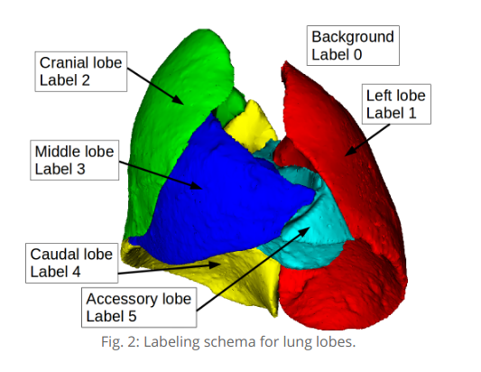

Slide 3
Strain B6C3F1
Name | Strain | Gender | Weight | Particle_Size
m02 | B6C3F1 | F | 19.5 | 1
m06 | B6C3F1 | F | 21 | 1
m01 | B6C3F1 | M | N/A | 1
m11 | B6C3F1 | M | 23.4 | 1

Slide 4
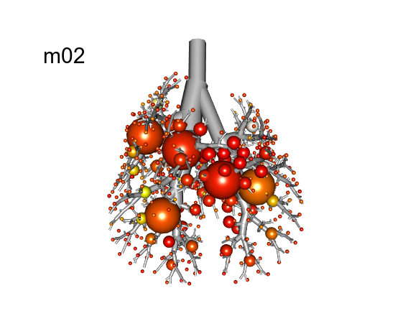
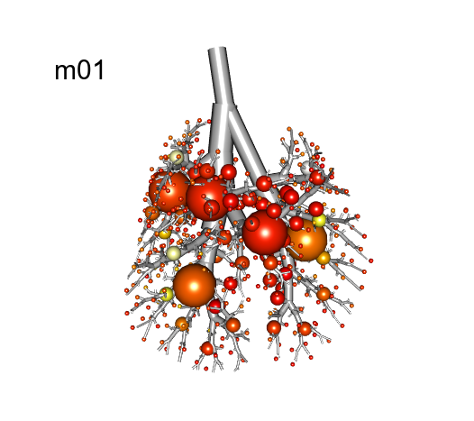
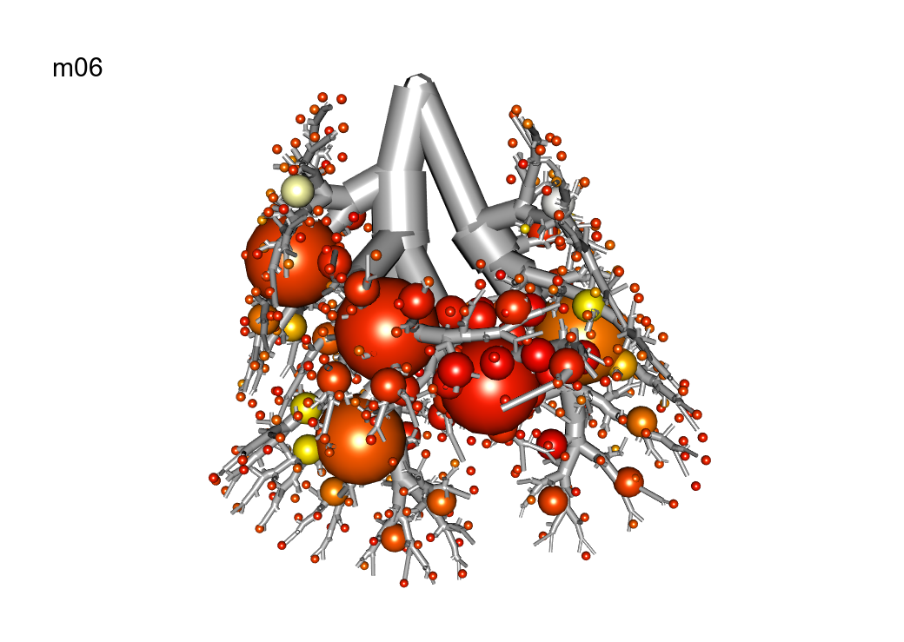
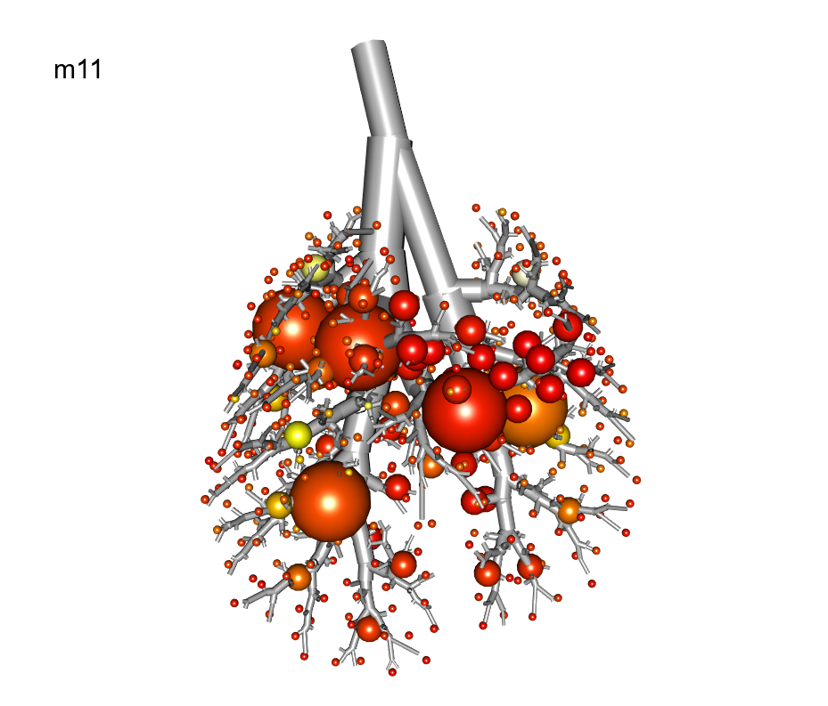

Slide 5
Sample Name | Breathe in | in std | Breathe out | out std | Respiratory Rate | RR Max | RR Min | RR std | Time Span
m01_Ventilation_Pre | 73.4 | 20.3 | -6.7 | 3.3 | 166 | 180 | 158 | 7.7 | 4.7
m01_Ventilation_Post1 | 81.5 | 23.9 | -6.7 | 1.8 | 168.2 | 178 | 163 | 3.3 | 4.9
m01_Ventilation_Post2 | 76.3 | 20.3 | -8.2 | 2.3 | 159.1 | 163 | 156 | 2 | 4.9
m02_Ventilation_Pre | 71.6 | 29.6 | -6.3 | 2.9 | 158.4 | 200 | 188 | 3.3 | 3.4
m02_Ventilation_Post1 | 41.3 | 13.9 | -6.6 | 5.1 | 140.1 | 152 | 132 | 5.3 | 5.2
m02_Ventilation_Post2 | 60.8 | 19.5 | -6.4 | 3.7 | 158.5 | 173 | 151 | 6.2 | 4.6
m06_Ventilation_Pre | 45.6 | 14.2 | -7.4 | 4.2 | 132.7 | 135 | 130 | 1.7 | 5
m06_Ventilation_Post1 | 55.2 | 17.7 | -7.6 | 3.2 | 133.7 | 168 | 162 | 1.8 | 4
m06_Ventilation_Post2 | 116.7 | 36.1 | -5.7 | 2.1 | 203.1 | 213 | 196 | 4.3 | 3.9
m11_Ventilation_Pre | 106.4 | 41.1 | -8.5 | 3.3 | 259.1 | 276 | 249 | 8.8 | 3.9
m11_Ventilation_Post1 | 73.2 | 25.3 | -8.8 | 2.9 | 203.1 | 218 | 184 | 12 | 2.9
m11_Ventilation_Post2 | 99.6 | 33.5 | -8.9 | 2.6 | 231.5 | 242 | 223 | 6.1 | 3.1

Slide 6
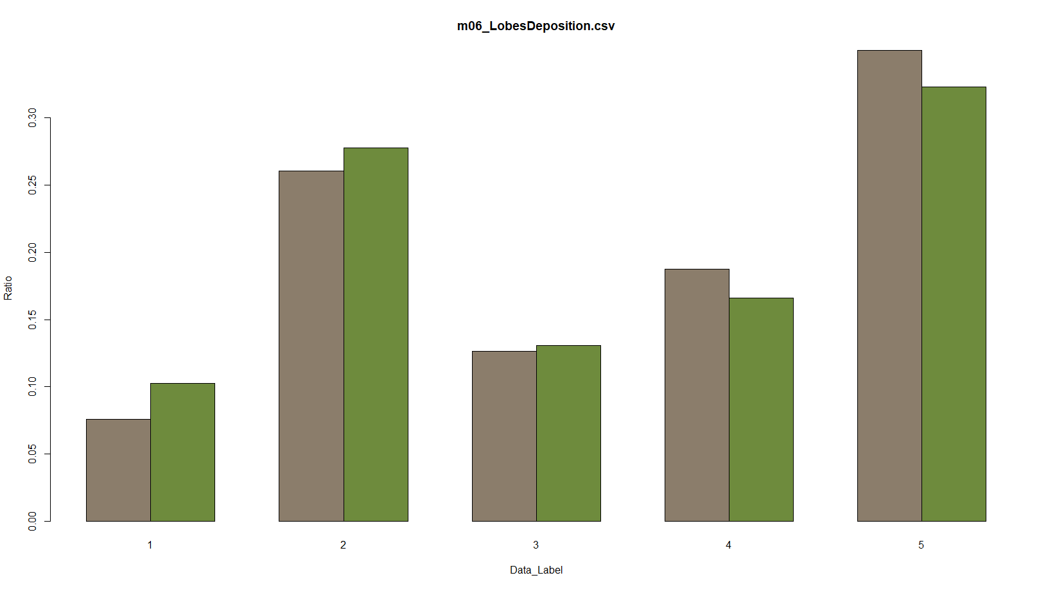
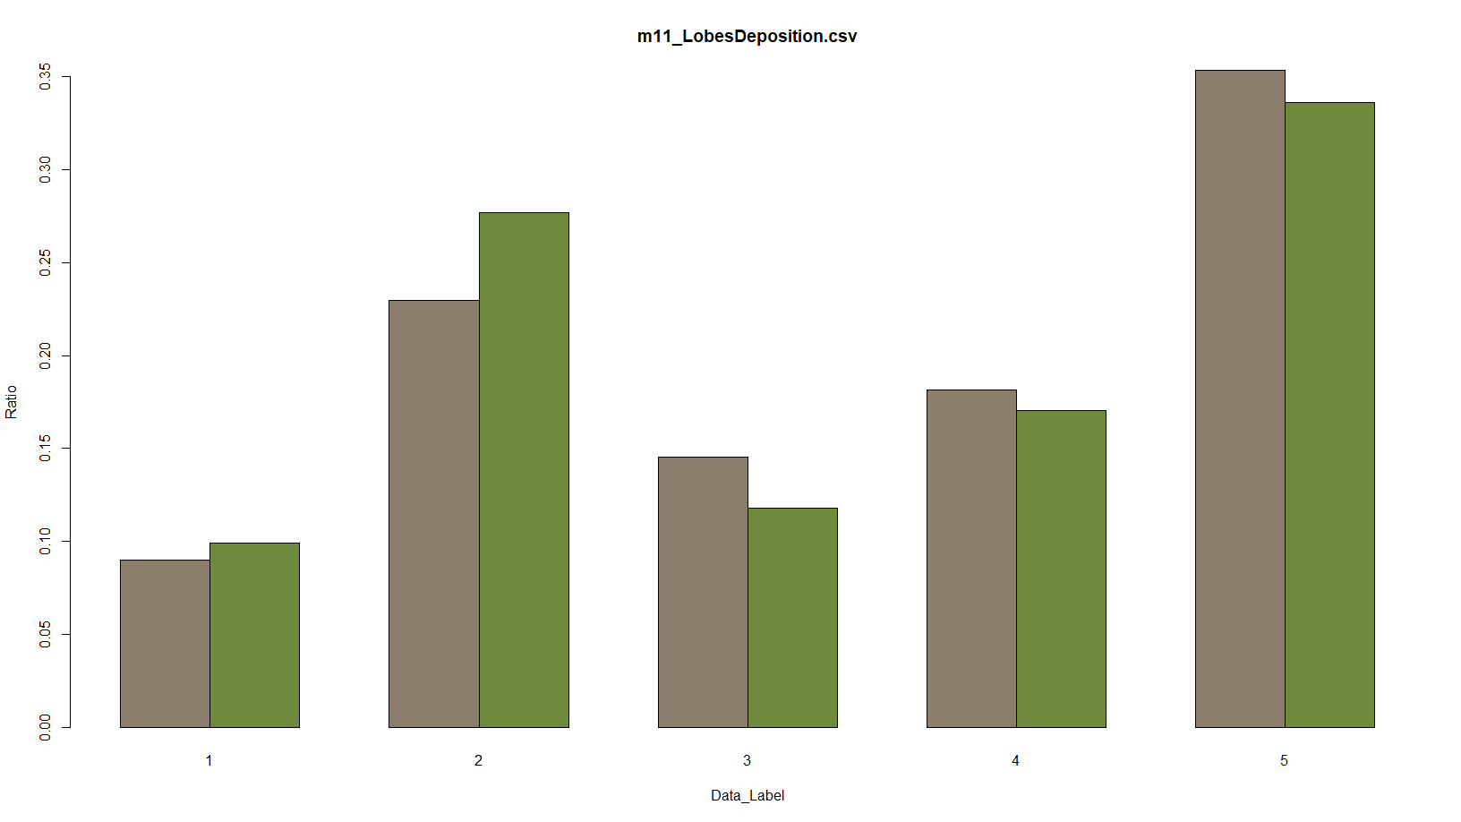
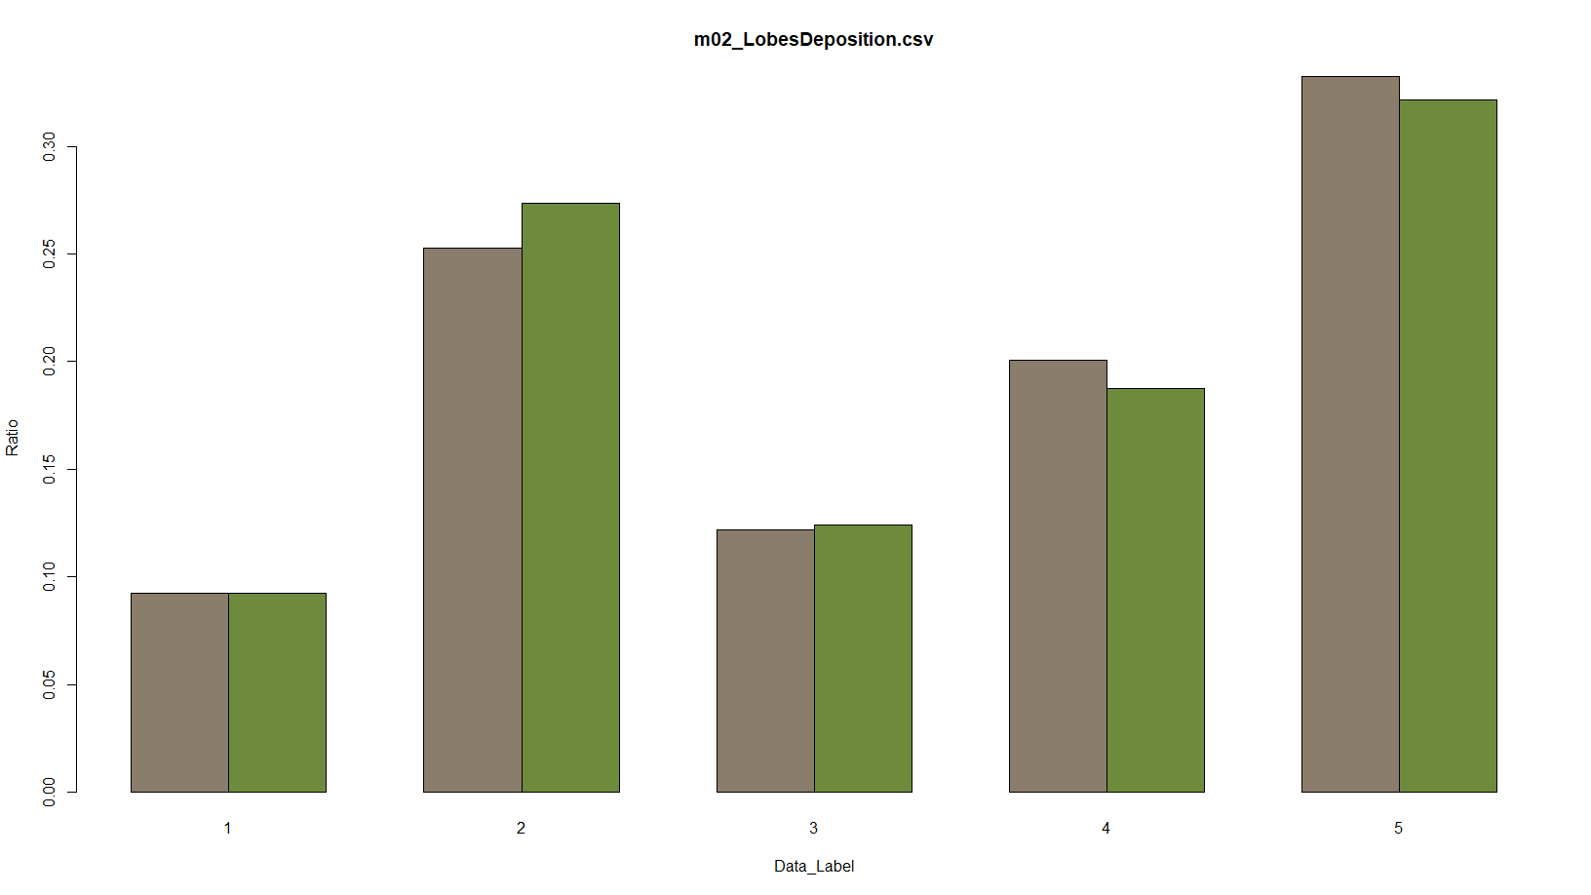
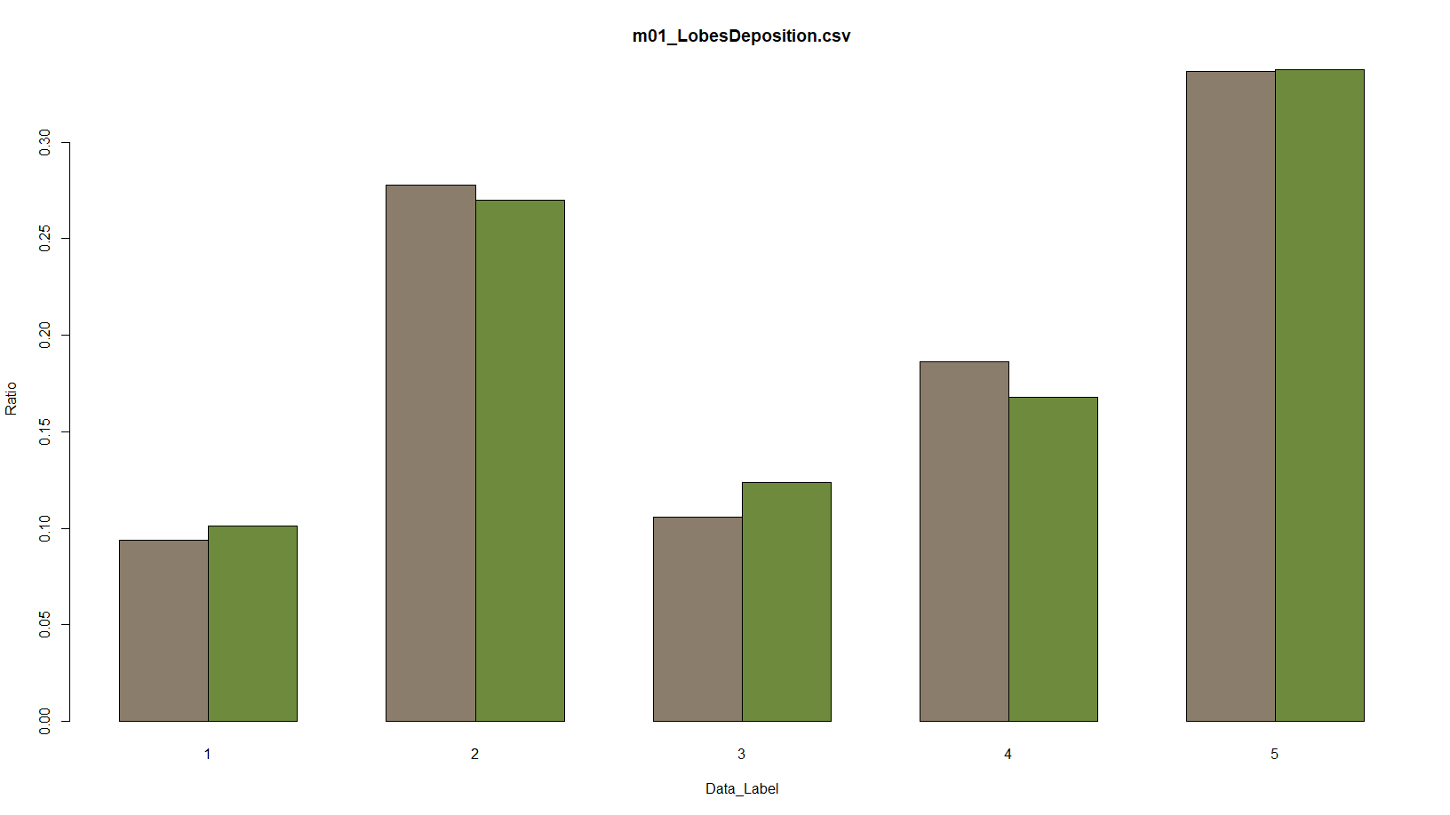

Slide 7
Strain BALB/C
Name | Strain | Gender | Weight | Particle_Size
m09 | BALB/c | F | 23.7 | 1
m10 | BALB/c | F | N/A | 1
m03 | BALB/c | M | 23.8 | 1

Slide 8
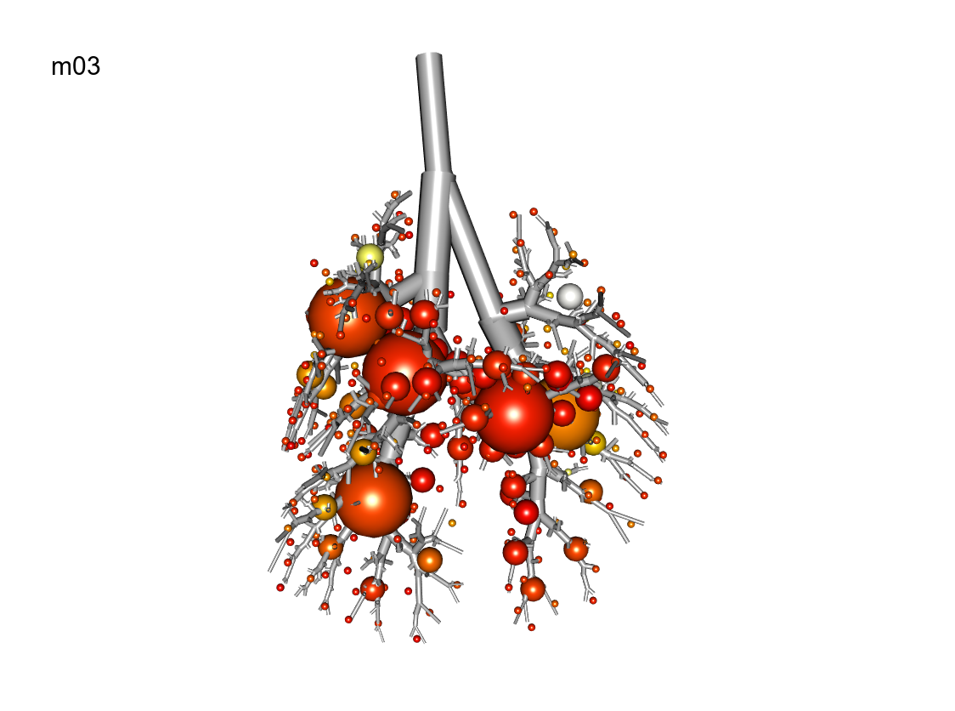
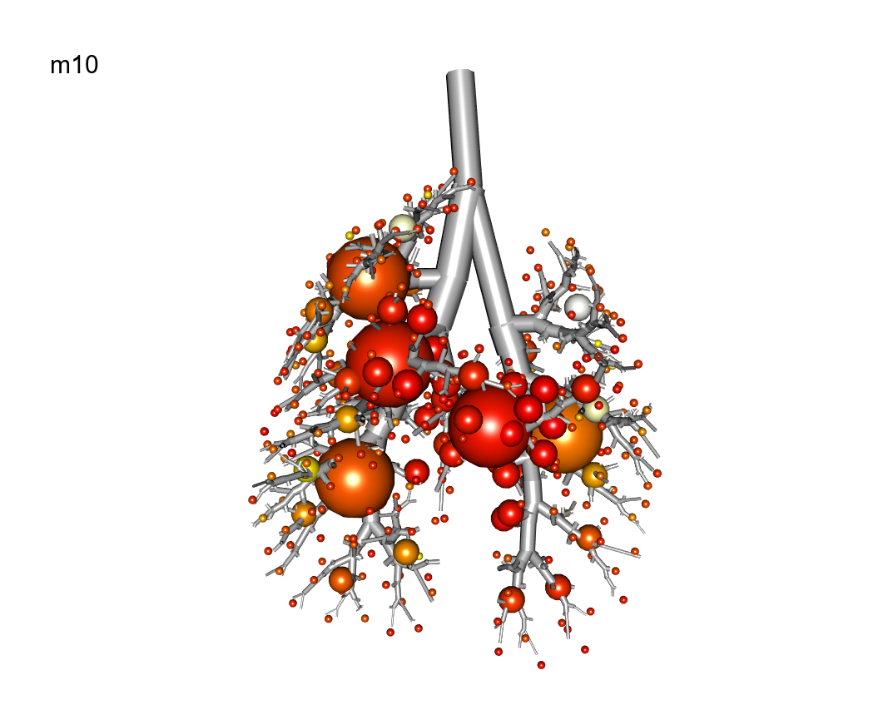
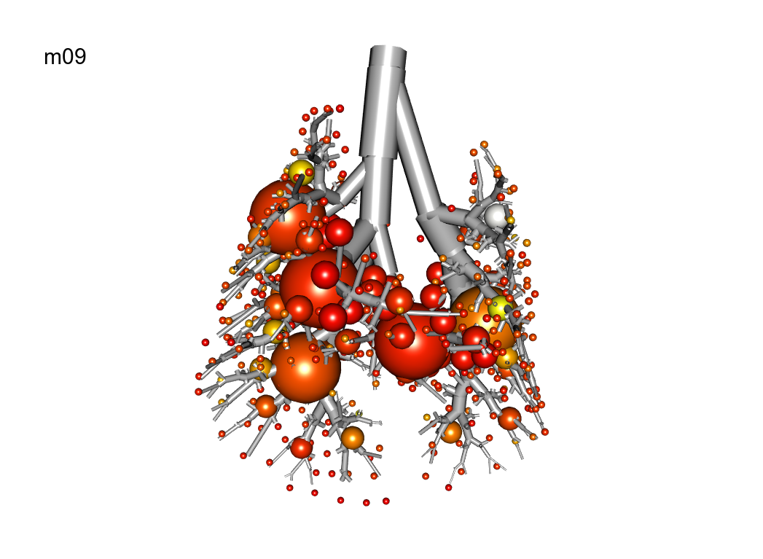

Slide 9
Sample Name | Breathe in | in std | Breathe out | out std | Respiratory Rate | RR Max | RR Min | RR std | Time Span
m03_Ventilation_Pre | 113.8 | 36.3 | -6.5 | 2.4 | 278.5 | 282 | 274 | 2.5 | 2.8
m03_Ventilation_Post1 | 122.6 | 41.9 | -6.4 | 2.5 | 303.7 | 320 | 295 | 7.6 | 3.3
m03_Ventilation_Post2 | 56.2 | 19.6 | -9.3 | 3.4 | 178.7 | 188 | 168 | 4.4 | 4.2
m09_Ventilation_Pre | 120.4 | 37.4 | -5 | 2.7 | 221.7 | 245 | 208 | 13 | 5.1
m09_Ventilation_Post1 | 113.5 | 40 | -5.1 | 2.6 | 216 | 231 | 205 | 7.5 | 3.8
m09_Ventilation_Post2 | 151.6 | 52.3 | -4.9 | 2.4 | 234.5 | 260 | 222 | 12 | 2.3
m10_Ventilation_Pre | 146.5 | 45.9 | -5.1 | 2.2 | 236.4 | 240 | 232 | 2.6 | 2.2
m10_Ventilation_Post1 | 113.4 | 40.8 | -5.2 | 2.1 | 228.8 | 254 | 213 | 10.5 | 3.7
m10_Ventilation_Post2 | 115.1 | 41.3 | -5.1 | 2.5 | 229.8 | 261 | 210 | 16.6 | 3.9

Slide 10
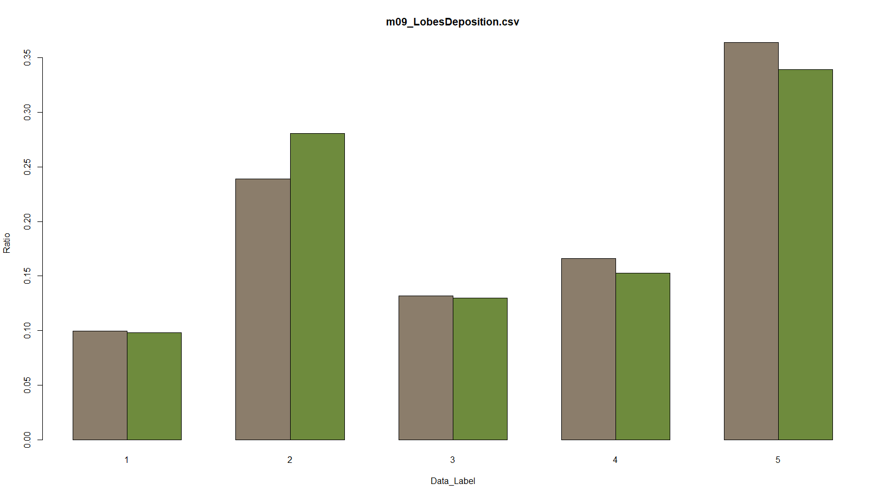
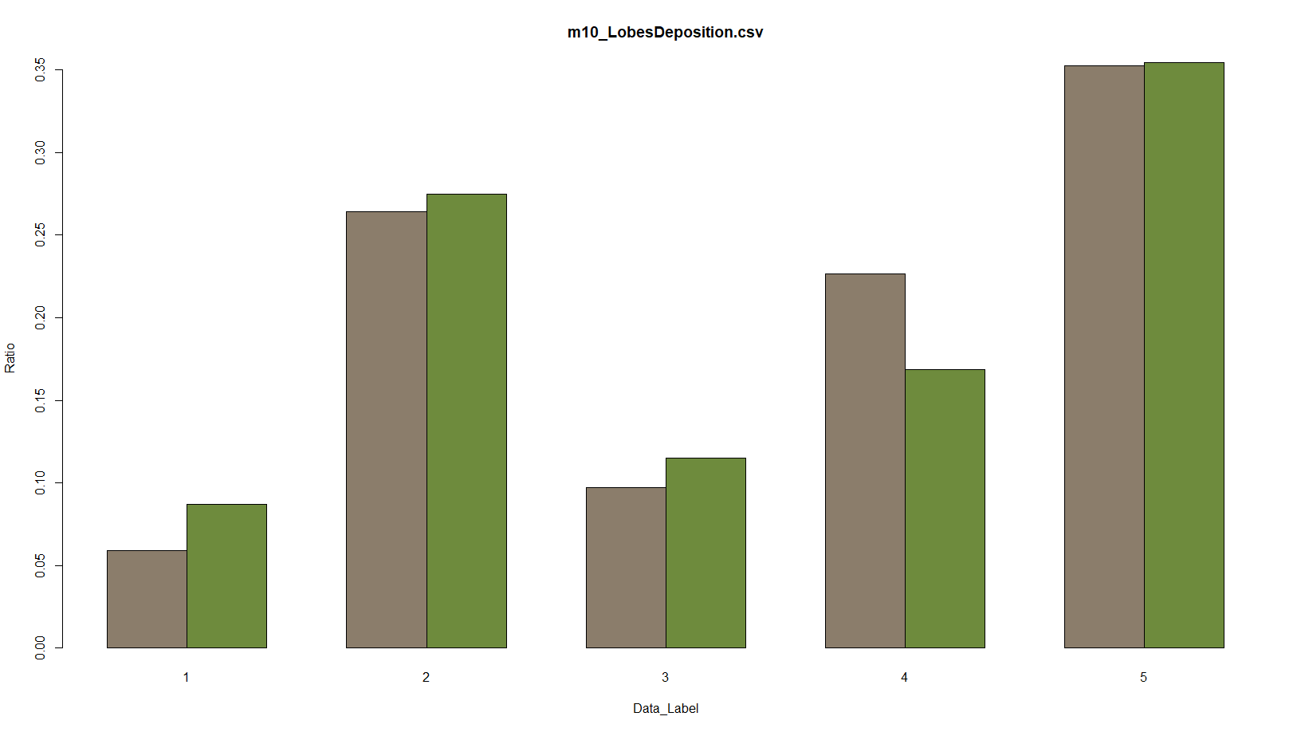
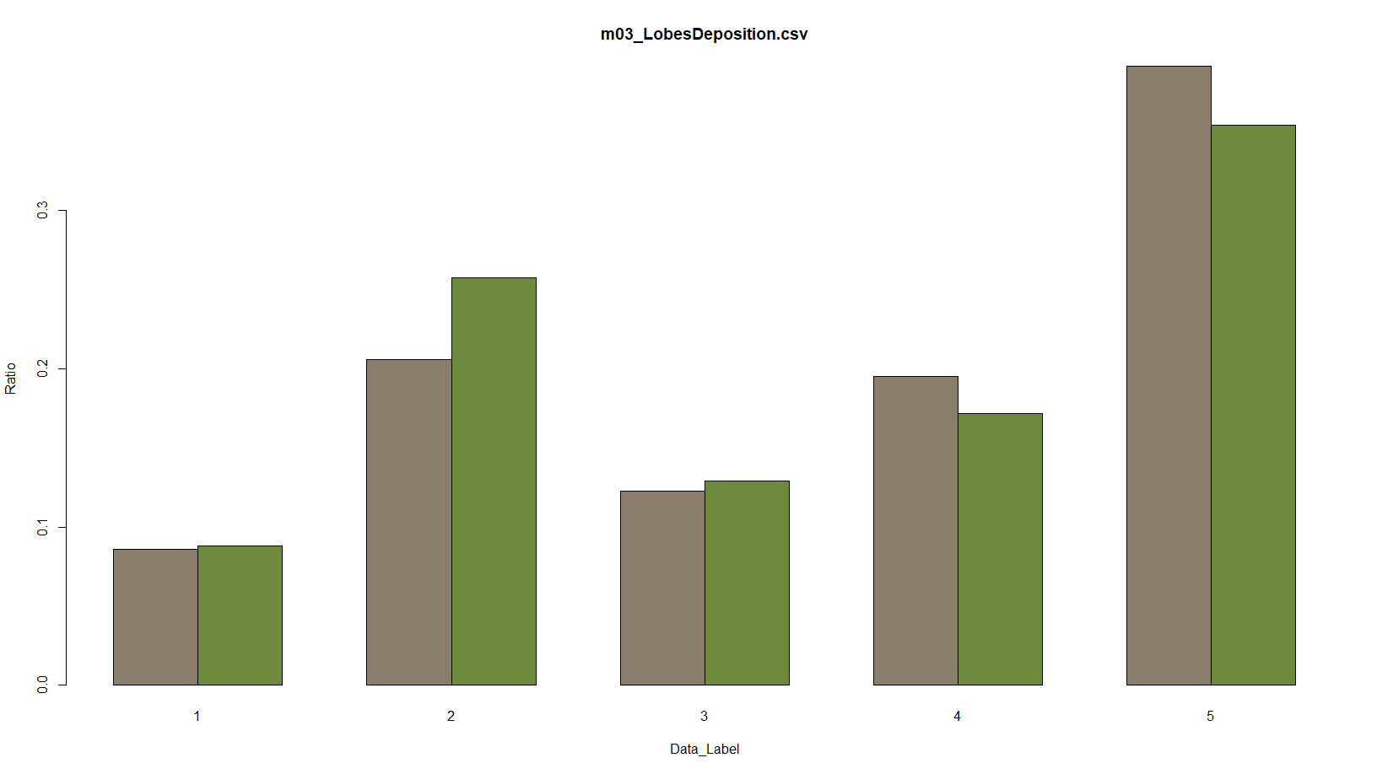

Slide 11
Strain C57BL/6
Name | Strain | Gender | Weight | Particle_Size
m08 | C57BL/6 | F | 23 | 1
m07 | C57BL/6 | M | 24.1 | 1
m14 | C57Bl/6 | M | NaN | 1

Slide 12
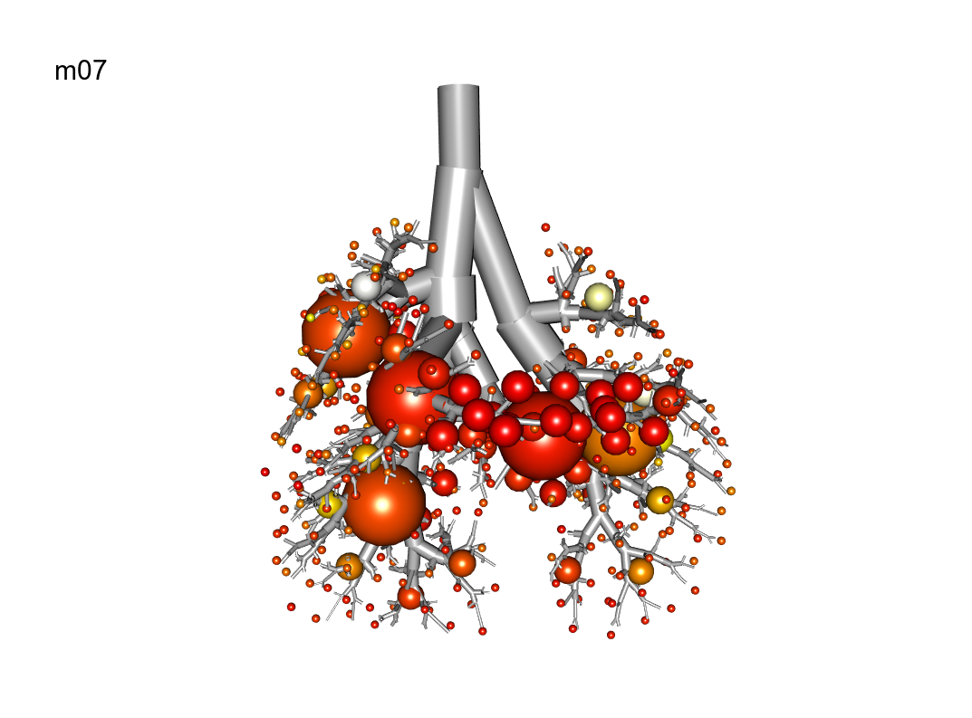
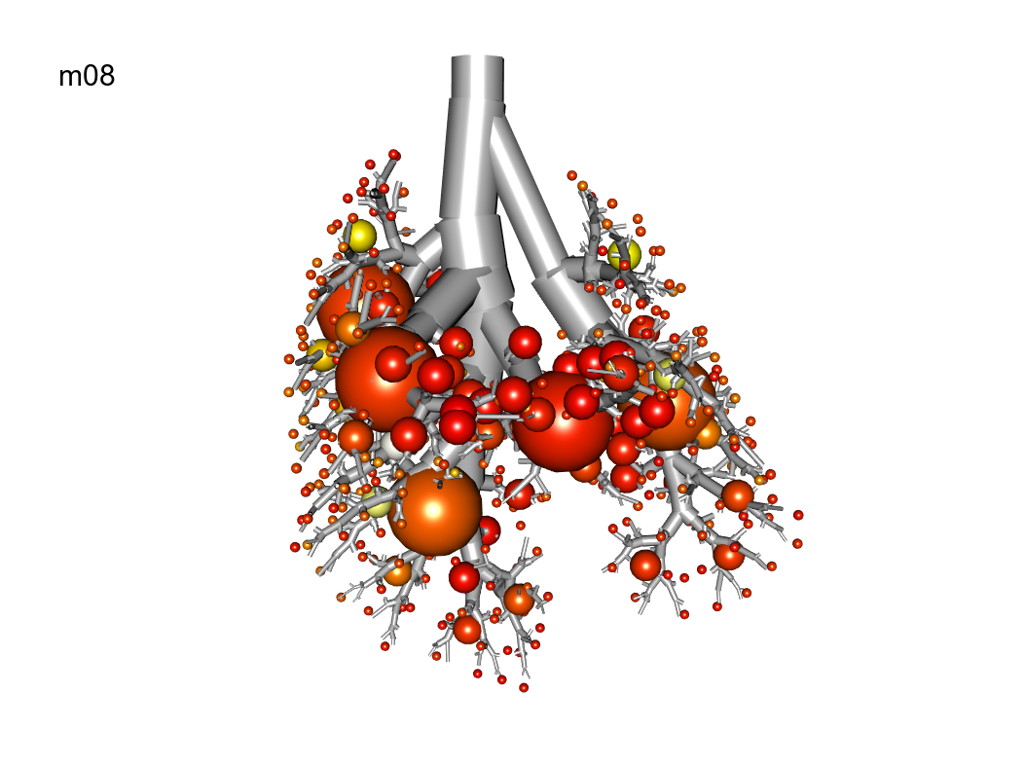
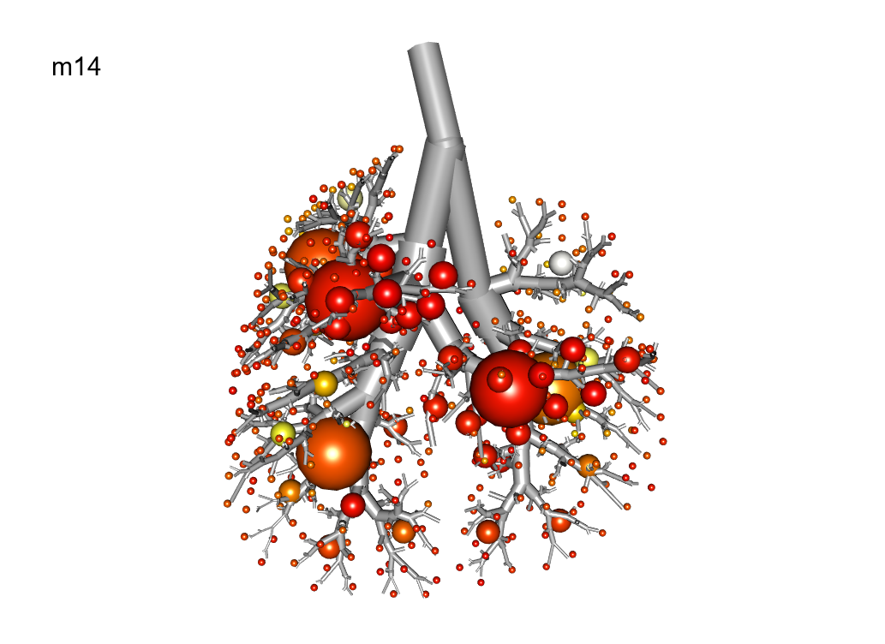

Slide 13
Sample Name | Breathe in | in std | Breathe out | out std | Respiratory Rate | RR Max | RR Min | RR std | Time Span
m07_Ventilation_Pre | 162.5 | 57.7 | -5.7 | 2.1 | 272.3 | 317 | 252 | 17.7 | 3.2
m07_Ventilation_Post1 | 119.1 | 45.5 | -6.2 | 2.6 | 218.9 | 231 | 207 | 7.5 | 3.5
m07_Ventilation_Post2 | 125.3 | 47.9 | -6.3 | 2.1 | 224.6 | 234 | 214 | 6.4 | 3.5
m08_Ventilation_Pre | 164.7 | 57.8 | -6.6 | 1.7 | 240.6 | 243 | 237 | 1.9 | 2.7
m08_Ventilation_Post1 | 133.9 | 51.4 | -6.7 | 2.7 | 210.6 | 216 | 194 | 7 | 3.9
m08_Ventilation_Post2 | 131.3 | 51.3 | -7.4 | 2.5 | 178 | 194 | 166 | 9.5 | 3.7
m14_Ventilation_Pre | 178.5 | 57.2 | -6.1 | 1.4 | 259.2 | 267 | 252 | 4.6 | 3.2
m14_Ventilation_Post1 | 162.6 | 56.5 | -6 | 2.1 | 253.3 | 258 | 247 | 2.8 | 3.1
m14_Ventilation_Post2 | 135.6 | 50.3 | -6.1 | 2.4 | 215.3 | 227 | 204 | 7.4 | 3

Slide 14
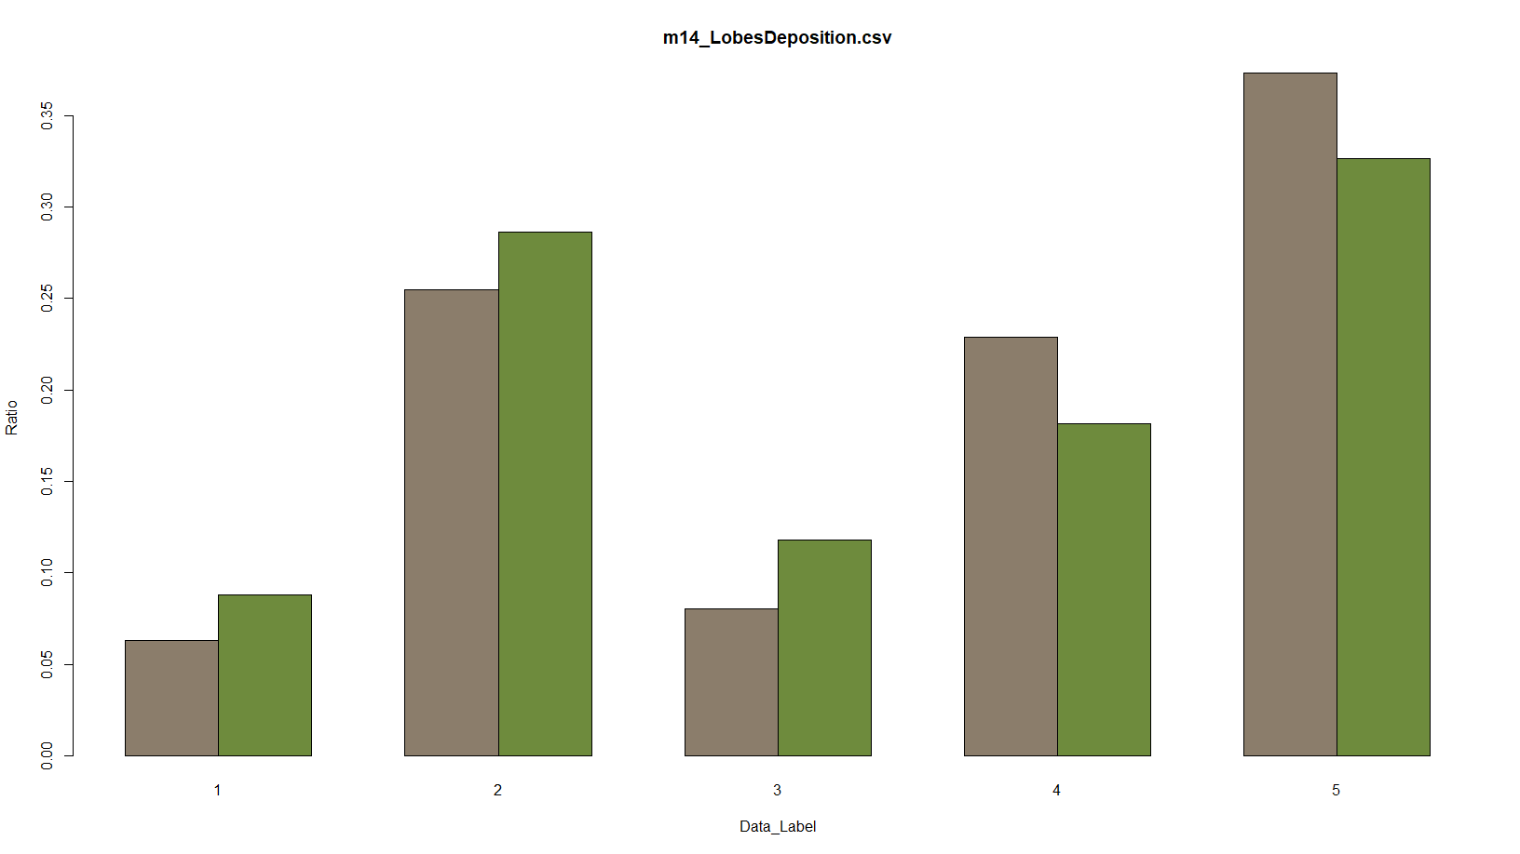
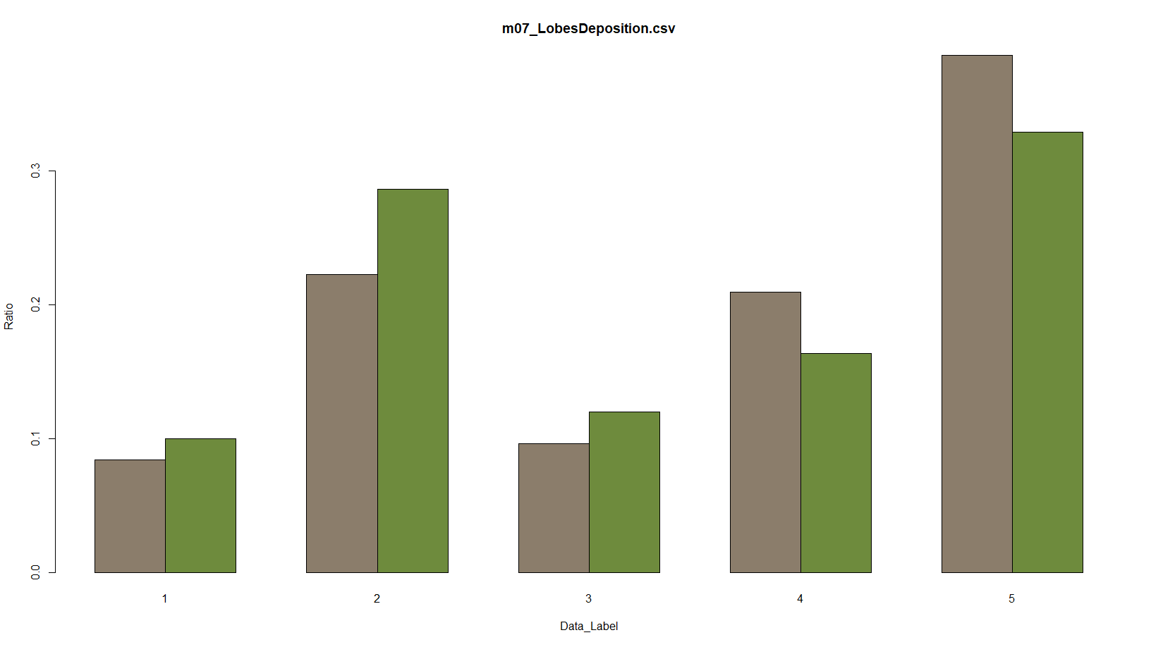
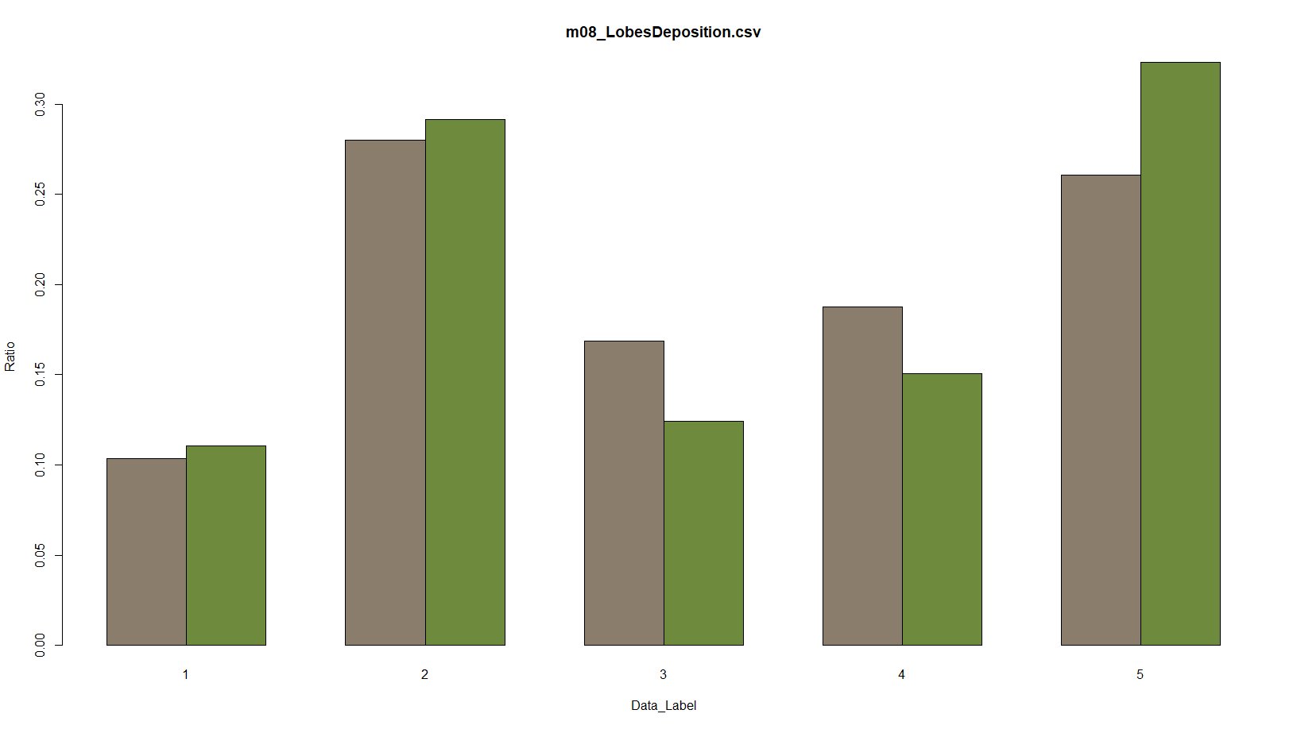

Slide 15
Strain CD-1
Name | Strain | Gender | Weight | Particle_Size
m12 | CD-1 | F | 24.5 | 1
m13 | CD-1 | F | 23.4 | 1
m04 | CD-1 | M | 24.4 | 1
m05 | CD-1 | M | N/A | 1

Slide 16
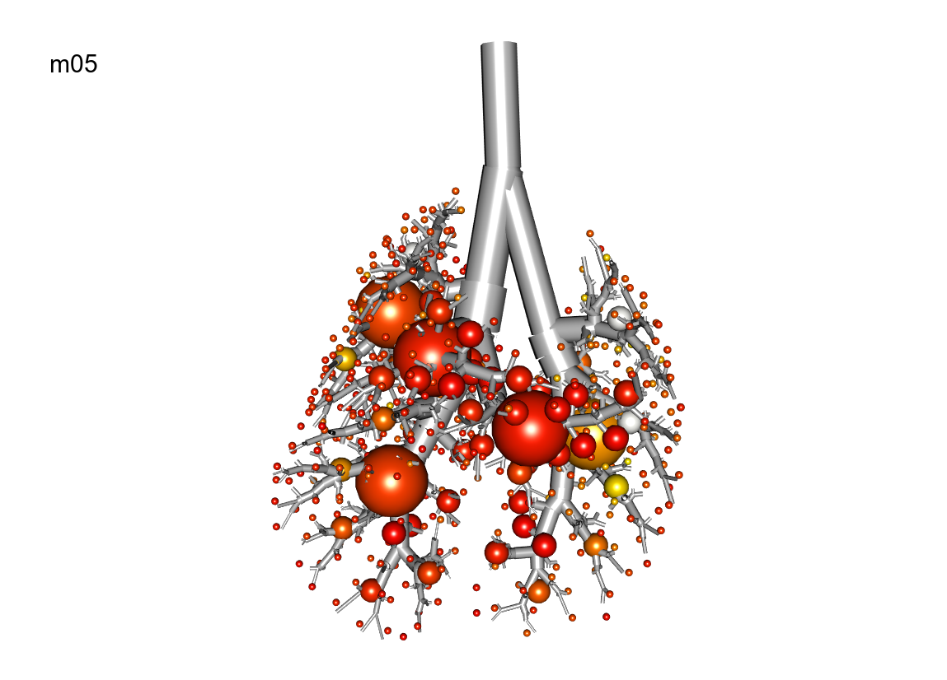
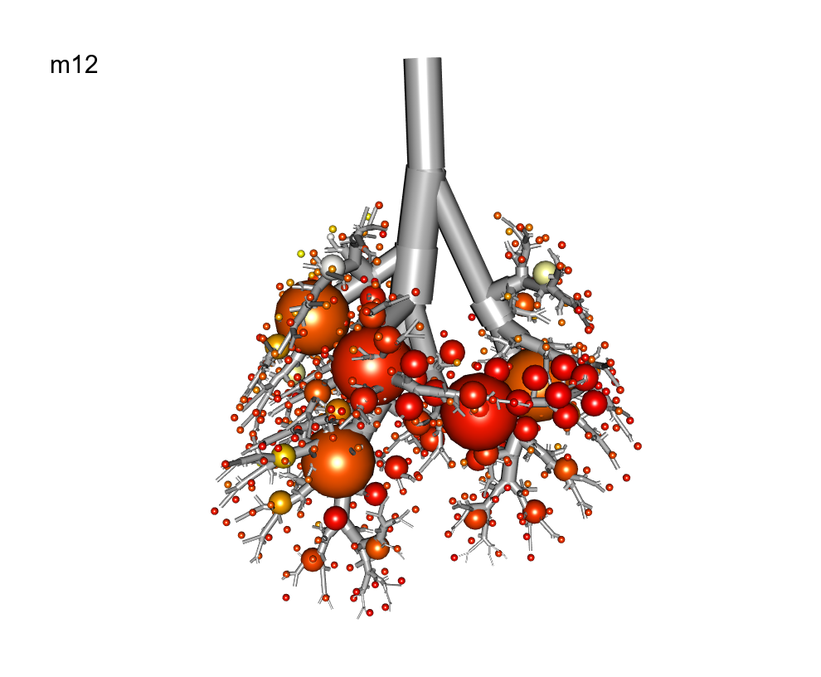
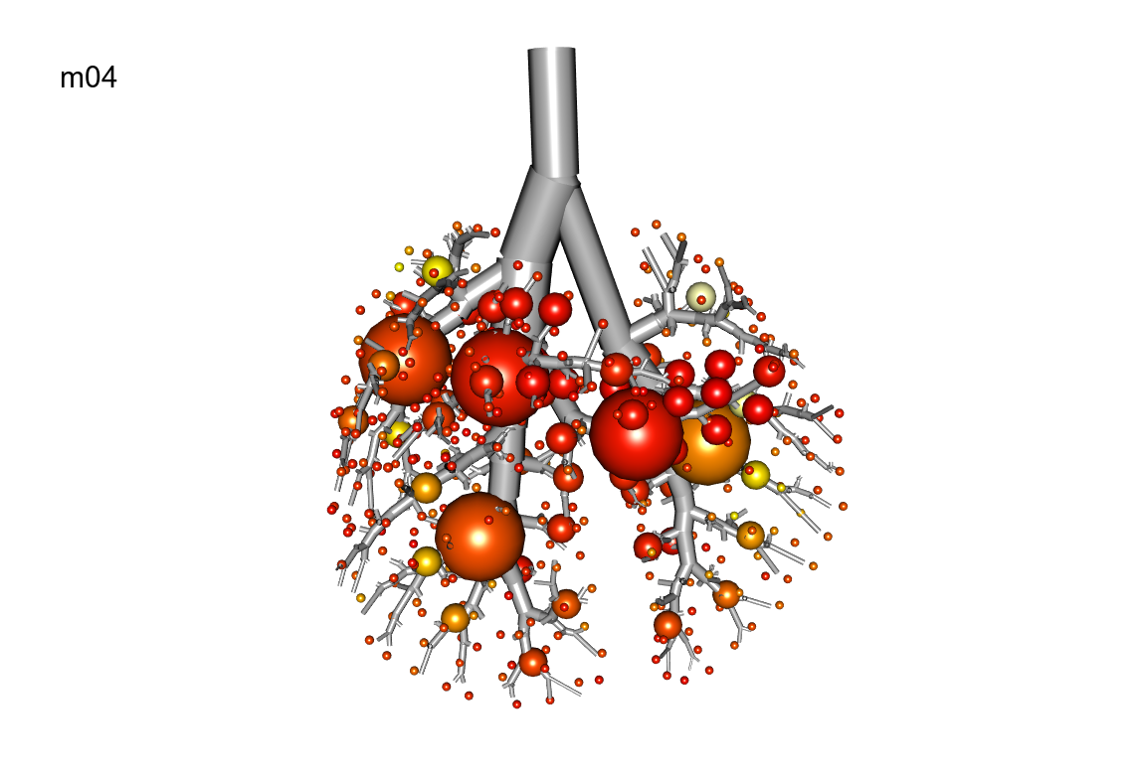
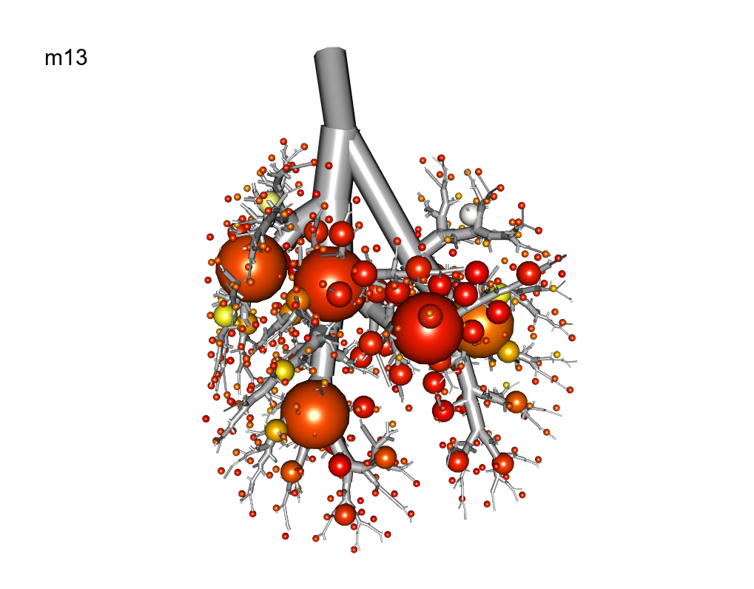

Slide 17
Sample Name | Breathe in | in std | Breathe out | out std | Respiratory Rate | RR Max | RR Min | RR std | Time Span
m04_Ventilation_Pre | 100.3 | 45 | -5.4 | 4.2 | 135 | 153 | 119 | 9.7 | 5.6
m04_Ventilation_Post1 | 99.9 | 49.5 | -3.1 | 4.8 | 96.6 | 101 | 90 | 3.7 | 5.2
m04_Ventilation_Post2 | 80.1 | 23.2 | -7.3 | 2.8 | 98.6 | 106 | 92 | 3.5 | 10.8
m05_Ventilation_Pre | 96.9 | 30.9 | -5.9 | 2.6 | 135.4 | 139 | 132 | 1.6 | 5.8
m05_Ventilation_Post1 | 85.5 | 26.2 | -7.7 | 2.3 | 122.5 | 132 | 116 | 4.7 | 6.9
m05_Ventilation_Post2 | 101.9 | 30.7 | -6.4 | 1.8 | 137.4 | 143 | 132 | 3.5 | 4.4
m12_Ventilation_Pre | 162 | 44.2 | -6.8 | 1.7 | 219.2 | 228 | 216 | 3.5 | 3.3
m12_Ventilation_Post1 | 179.1 | 51.2 | -6.7 | 2.2 | 241.6 | 245 | 236 | 3.1 | 3.2
m12_Ventilation_Post2 | 147.3 | 40 | -6.8 | 1.2 | 188.8 | 195 | 184 | 3.5 | 3.5
m13_Ventilation_Pre | 97.2 | 26 | -6.8 | 1.9 | 160.5 | 165 | 156 | 1.8 | 4.1
m13_Ventilation_Post1 | 89.6 | 21.7 | -8.6 | 2.4 | 119.9 | 127 | 112 | 4.7 | 6.1
m13_Ventilation_Post2 | 91.2 | 26.6 | -9 | 2.5 | 114.2 | 124 | 106 | 4.4 | 7.8

Slide 18
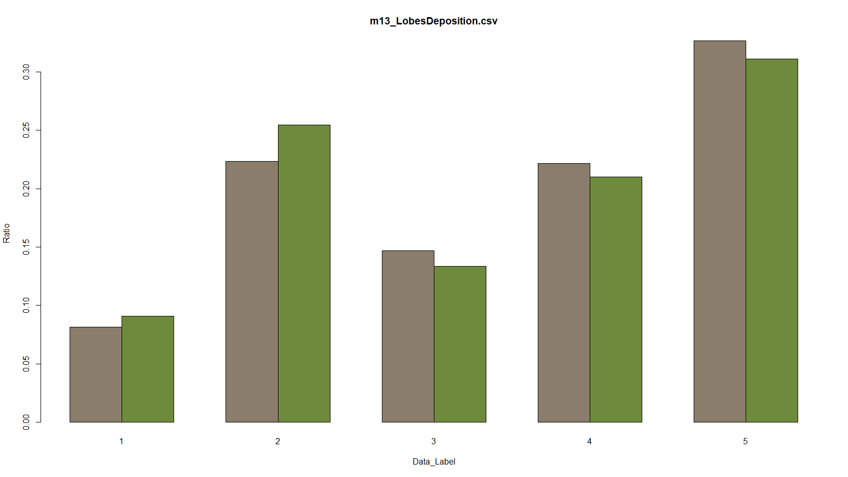
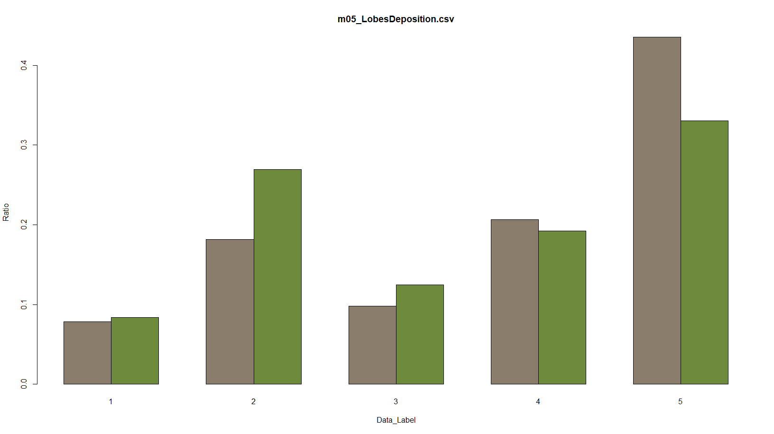
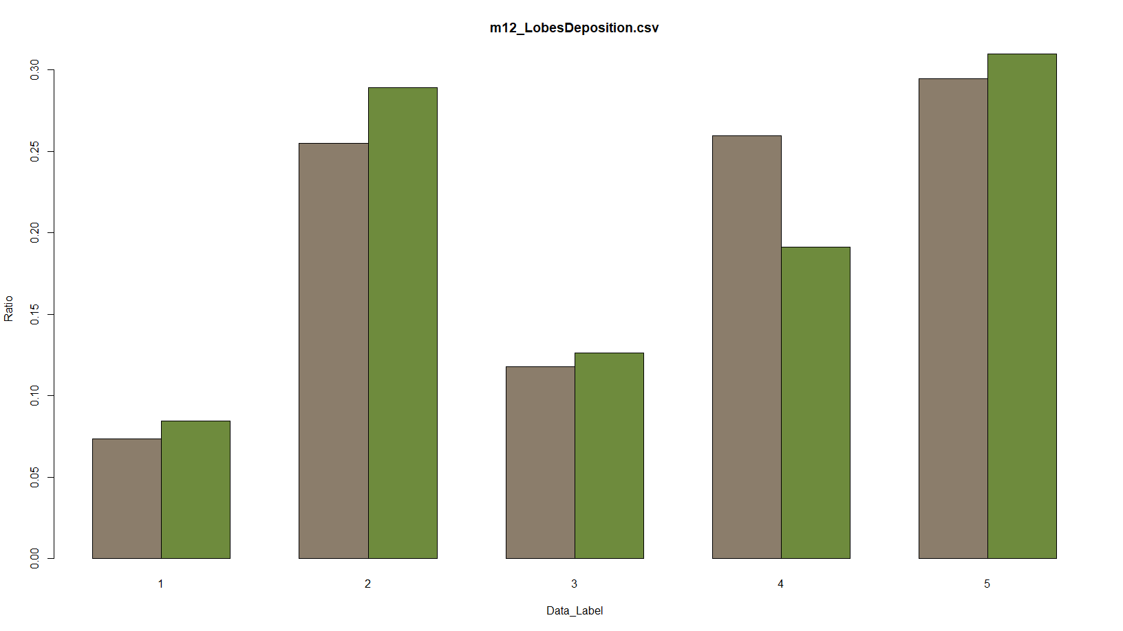
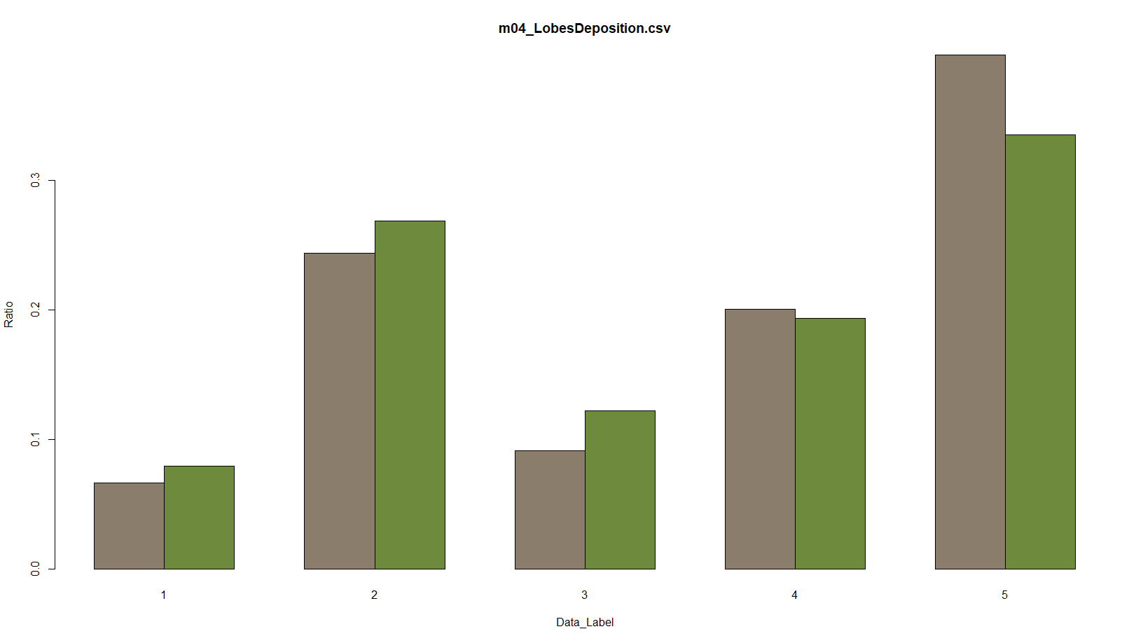

Slide 19
Particle size of 2 Microns
Name | Strain | Gender | Weight | Particle_Size
m15 | B6C3F1 | M | 23.8 | 2
m17 | C57BL/6 | F | NaN | 2
m16 | C57BL/6 | M | 22 | 2
m18 | CD-1 | F | 23.2 | 2

Slide 20
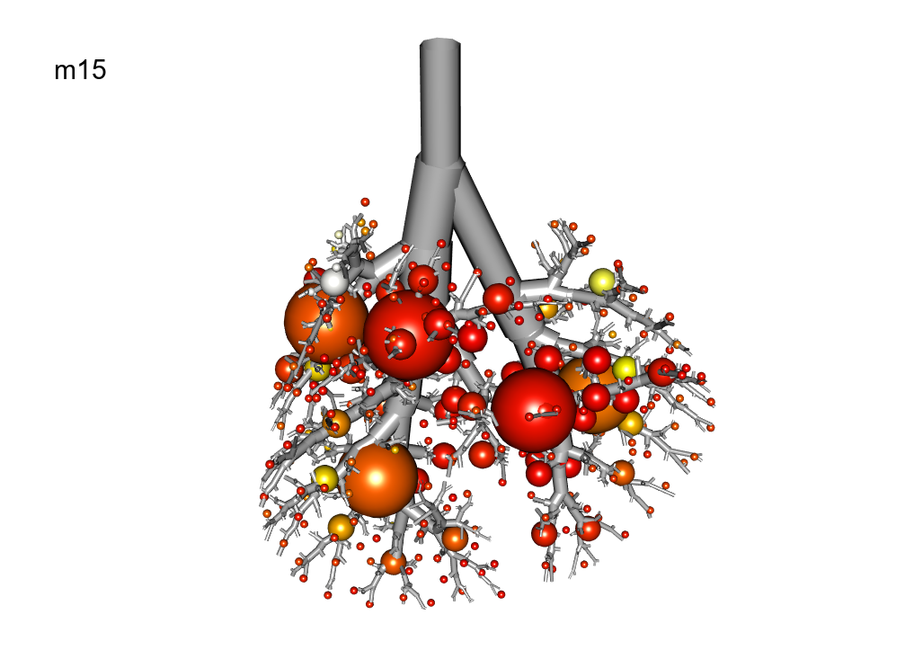
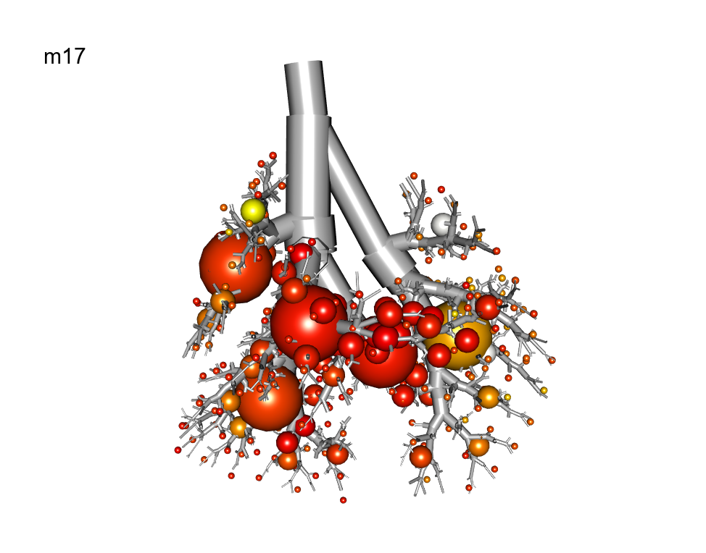
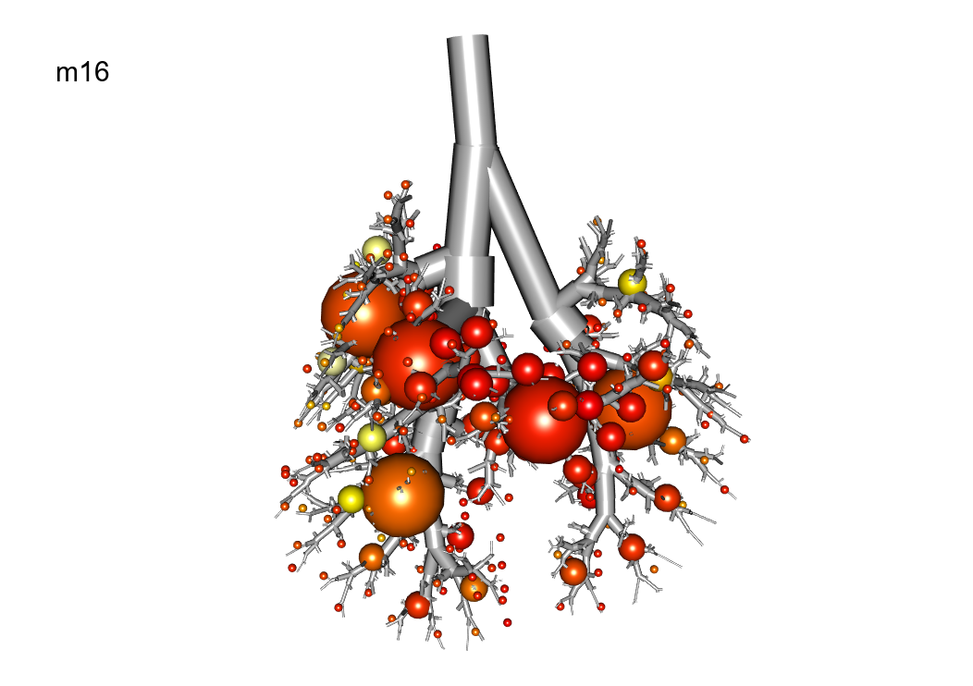
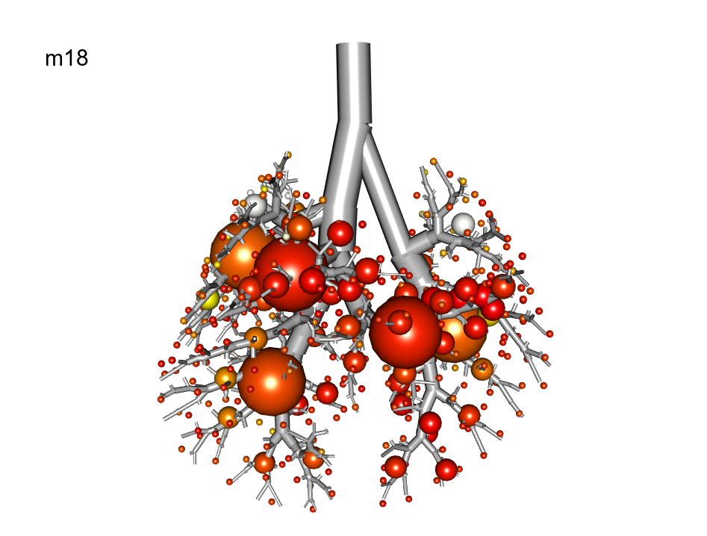

Slide 21
Sample Name | Breathe in | in std | Breathe out | out std | Respiratory Rate | RR Max | RR Min | RR std | Time Span
m15_Ventilation_Pre | 123.1 | 37.8 | -6.6 | 2 | 221.9 | 229 | 214 | 4.5 | 4.6
m15_Ventilation_Post1 | 105.7 | 35.1 | -6.8 | 1.9 | 182 | 188 | 177 | 4.6 | 1.6
m15_Ventilation_Post2 | 115.8 | 39.3 | -6.7 | 2.6 | 190.9 | 195 | 188 | 2.4 | 3.8
m16_Ventilation_Pre | 157.8 | 60.5 | -6.6 | 2.5 | 285.6 | 330 | 262 | 20.7 | 4.9
m16_Ventilation_Post1 | 157.5 | 62 | -6.7 | 2.2 | 281.2 | 288 | 273 | 3.9 | 4.7
m16_Ventilation_Post2 | 163.2 | 63.6 | -6.8 | 1.8 | 270.1 | 283 | 258 | 6.6 | 4.8
m17_Ventilation_Pre | 149.6 | 51.4 | -6.6 | 2.3 | 280.9 | 287 | 270 | 4.6 | 4.7
m17_Ventilation_Post1 | 110.8 | 43.5 | -6.7 | 2.8 | 238.9 | 264 | 226 | 8.3 | 4.7
m17_Ventilation_Post2 | 87.4 | 33 | -6.2 | 3.1 | 197.2 | 230 | 172 | 19 | 5
m18_Ventilation_Pre | 152 | 44.6 | -6.7 | 2 | 243.9 | 246 | 241 | 1.4 | 4.9
m18_Ventilation_Post1 | 101.3 | 29.2 | -6.7 | 2.2 | 198.9 | 203 | 192 | 3.1 | 4.8
m18_Ventilation_Post2 | 110.9 | 31.5 | -6.7 | 1.7 | 201.2 | 204 | 198 | 1.5 | 4.7

Slide 22
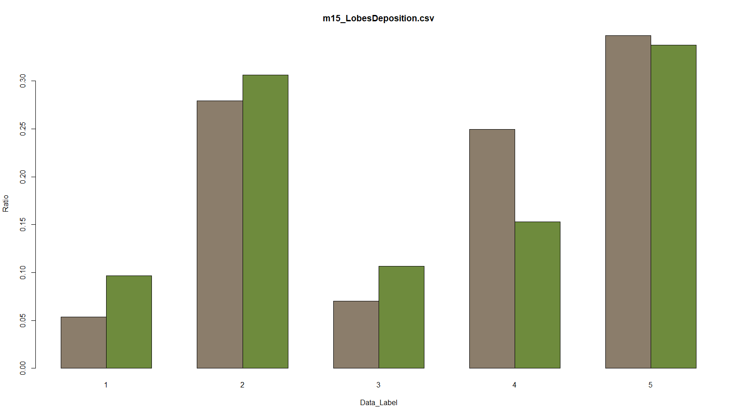
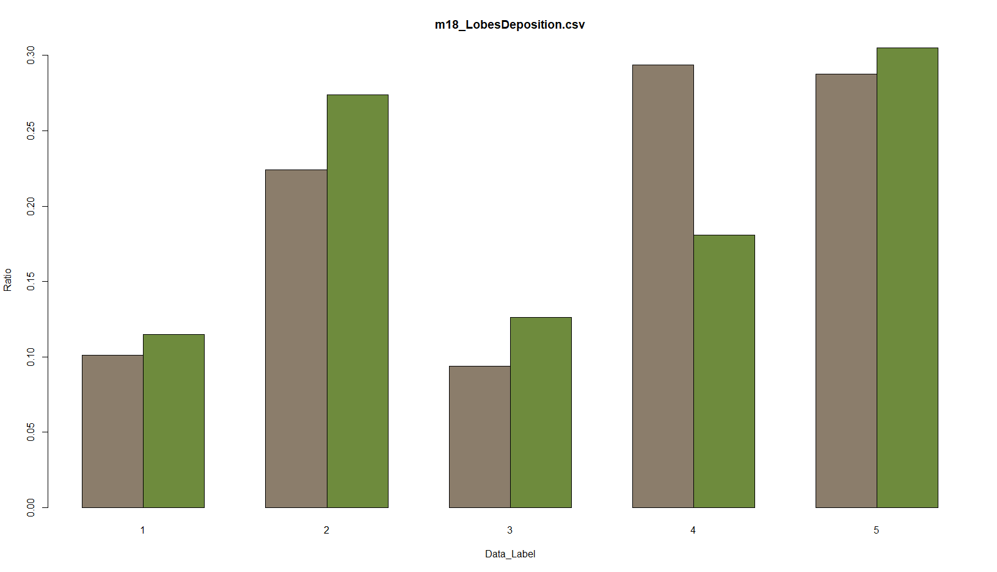
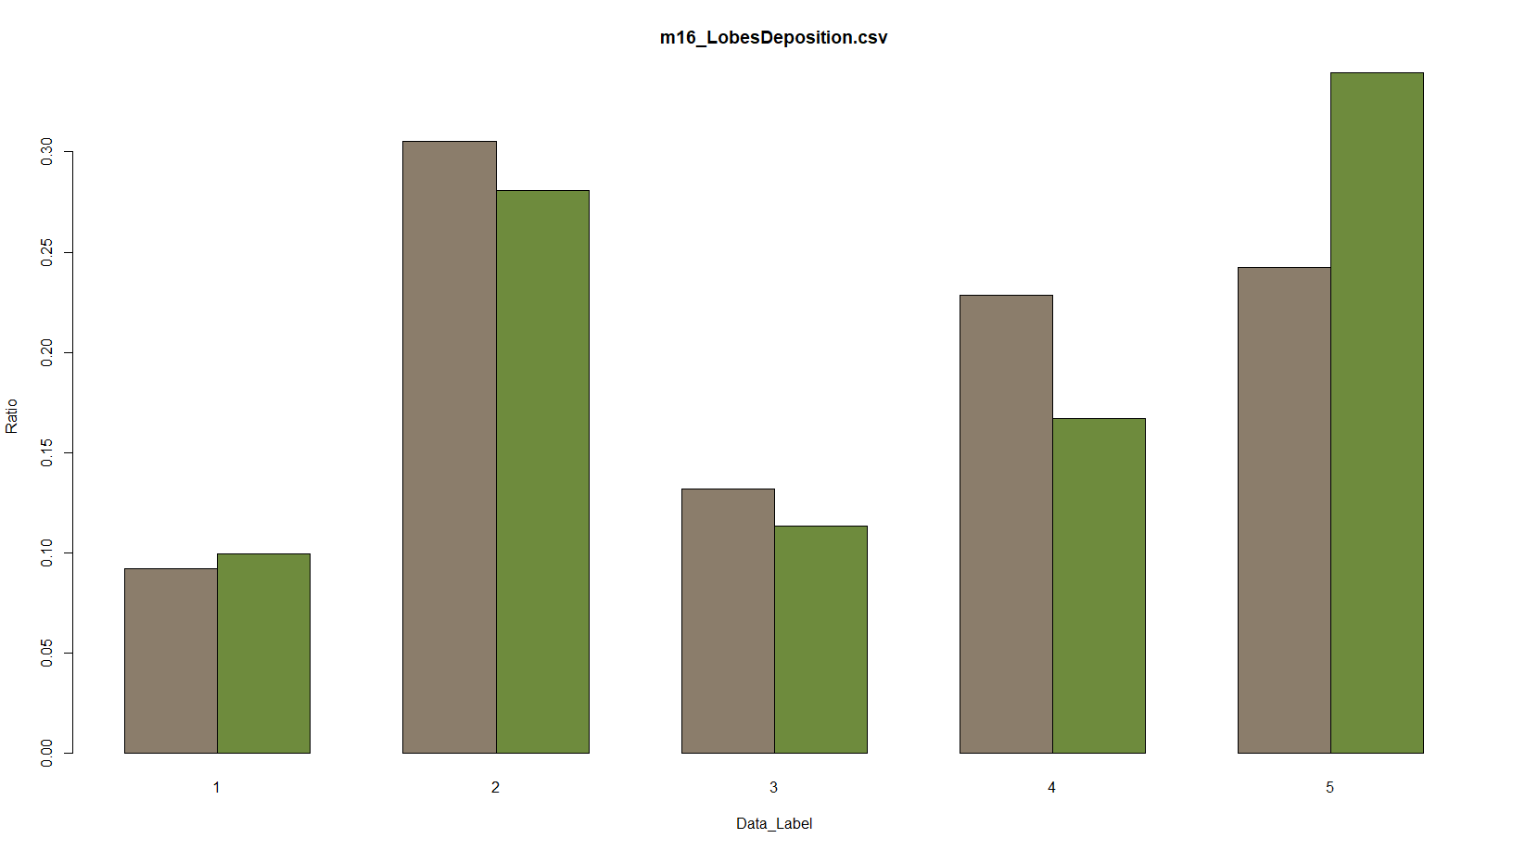
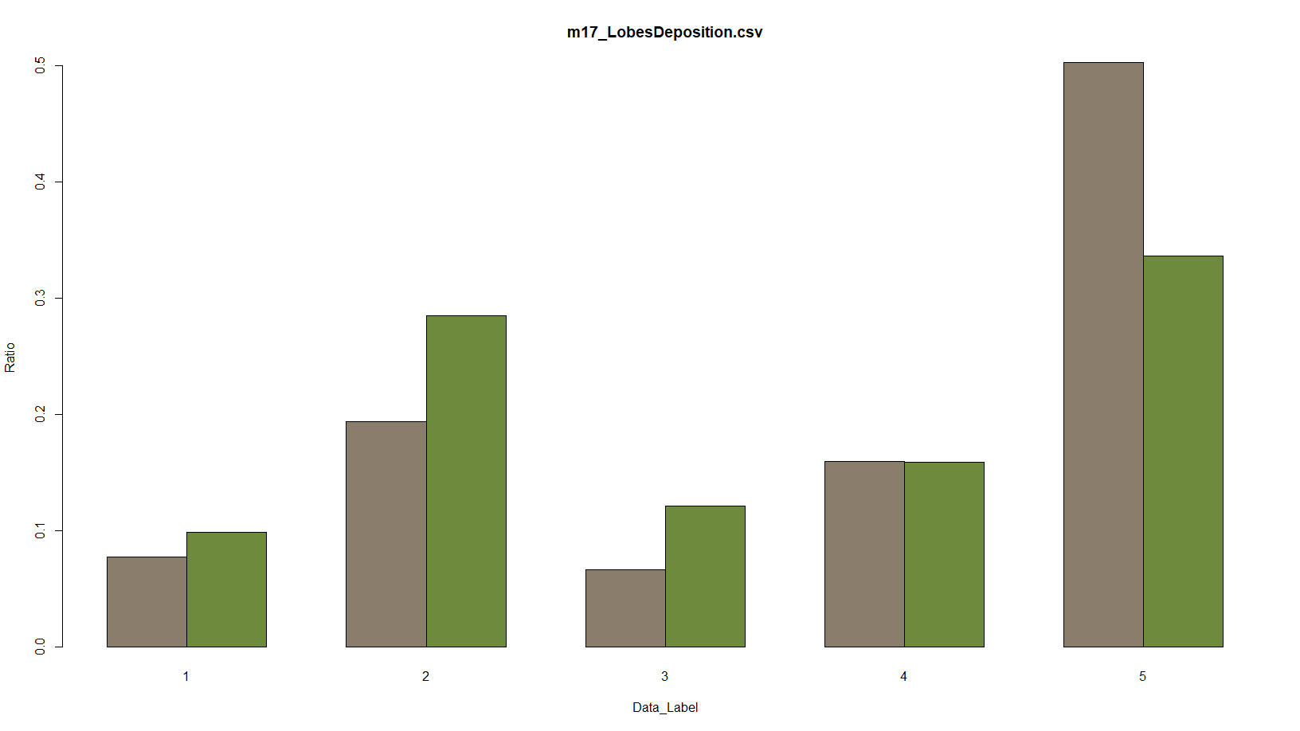

Slide 23
Strain C57Bl/6 with different particle size
Name | Strain | Gender | Weight | Particle_Size
m08 | C57BL/6 | F | 23 | 1
m07 | C57BL/6 | M | 24.1 | 1
m14 | C57Bl/6 | M | NaN | 1
m17 | C57BL/6 | F | NaN | 2
m16 | C57BL/6 | M | 22 | 2

Slide 26
Sample Name | Breathe in | in std | Breathe out | out std | Respiratory Rate | RR Max | RR Min | RR std | Time Span
m07_Ventilation_Pre | 162.5 | 57.7 | -5.7 | 2.1 | 272.3 | 317 | 252 | 17.7 | 3.2
m07_Ventilation_Post1 | 119.1 | 45.5 | -6.2 | 2.6 | 218.9 | 231 | 207 | 7.5 | 3.5
m07_Ventilation_Post2 | 125.3 | 47.9 | -6.3 | 2.1 | 224.6 | 234 | 214 | 6.4 | 3.5
m08_Ventilation_Pre | 164.7 | 57.8 | -6.6 | 1.7 | 240.6 | 243 | 237 | 1.9 | 2.7
m08_Ventilation_Post1 | 133.9 | 51.4 | -6.7 | 2.7 | 210.6 | 216 | 194 | 7 | 3.9
m08_Ventilation_Post2 | 131.3 | 51.3 | -7.4 | 2.5 | 178 | 194 | 166 | 9.5 | 3.7
m14_Ventilation_Pre | 178.5 | 57.2 | -6.1 | 1.4 | 259.2 | 267 | 252 | 4.6 | 3.2
m14_Ventilation_Post1 | 162.6 | 56.5 | -6 | 2.1 | 253.3 | 258 | 247 | 2.8 | 3.1
m14_Ventilation_Post2 | 135.6 | 50.3 | -6.1 | 2.4 | 215.3 | 227 | 204 | 7.4 | 3

Slide 27
Sample Name | Breathe in | in std | Breathe out | out std | Respiratory Rate | RR Max | RR Min | RR std | Time Span
m16_Ventilation_Pre | 157.8 | 60.5 | -6.6 | 2.5 | 285.6 | 330 | 262 | 20.7 | 4.9
m16_Ventilation_Post1 | 157.5 | 62 | -6.7 | 2.2 | 281.2 | 288 | 273 | 3.9 | 4.7
m16_Ventilation_Post2 | 163.2 | 63.6 | -6.8 | 1.8 | 270.1 | 283 | 258 | 6.6 | 4.8
m17_Ventilation_Pre | 149.6 | 51.4 | -6.6 | 2.3 | 280.9 | 287 | 270 | 4.6 | 4.7
m17_Ventilation_Post1 | 110.8 | 43.5 | -6.7 | 2.8 | 238.9 | 264 | 226 | 8.3 | 4.7
m17_Ventilation_Post2 | 87.4 | 33 | -6.2 | 3.1 | 197.2 | 230 | 172 | 19 | 5

